Slide 1
Innovation @ Daman
Notes:
Good morning
I am not used to such a big classroom! Very impressive and slightly overwhelming.
I am Valerie the head of the Innovation Lab and I will go through these few slides to present the Innovation strategy .
The aim of this strategy is to prepare Daman for the future, to make Daman “futureproof ! “

Slide 2





Daman at a glance – 30 seconds of context
37 million
received claims p.a.
Around 3 million
members in the UAE
4.7 billion and growing
data points for advanced analytics
20% Munich Re
80% Abu Dhabi Government*
Total market share of around
40% in the UAE
667,000
managed calls p.a.
Launched in 2006
The widest
local provider network and
expanding international network
1,500+
employees, from
50+
nationalities
Award winning 30+ national and international recognitions

Slide 3




















Why does Daman need to innovate
Disruption is at our doorstep. Companies who refuse to innovate will not SURVIVE!
Which sector next ?
Insurance

Slide 4
The culture change
Making Daman “futureproof”
Notes:
Why do we need to innovate ?
“INNOVATE OR BECOME IRRELEVANT” _Coca Cola
Well I think you all have heard how disrupted certain industries have been in the last 2 decades.
New entrants have basically completely killed incumbents.
Think of Barnes & Nobel in the US
Think of HMV in the UK
When did you buy your last CD ? 7 -10 years ago ?
So look around!
whole industries are been disrupted by new young companies and
these companies often don’t know the sector but they have the technology, they own the customer interface.
The banking industry is being disrupted as we speak….
You probably have read that 2 weeks ago Amazon applied for an insurance license in India!
…. Insurance is next ! The clock is ticking !

Slide 5
Daman is getting ready for the future
Making Daman “futureproof”. we want to develop an innovation culture to prepare the company for the next challenges: new technologies, customer empowerment, new entrants, etc…
Mindset
Prompts
Developing the right corporate culture for people to drive motivation:
Innovation culture codes
Innovation Manifesto
Employee Engagement
Incentives
Giving people the opportunity to demonstrate the desired behavior:
Roles and Responsibilities
Action learnings
Exposure to start up working practices
Abilities
Can people do what they are requested to do ?
Do they know what we want them to do ?
Training
Communication
Community management
BJ Foogs Behavioral Model
Stanford university

Slide 6
The 3 pillars of the cultural transformation
Culture
Culture codes and manifesto
Skillset
Training program
The place to experiment:
Intra & external
Intrapreneurship
ideation campaigns and channels
External Ecosystem
Scouting solutions to bridge internal operational gaps
Experimentation @
the Lab
Culture Codes for Innovation
Innovation Management
Artificial Intelligence
Robotics
Data / Analytics
Innovation Culture Manifesto
Notes:
So how as do we become an “innovative company” ? Which behaviors do you need to change to embrace innovation ?
According to BJ Foogs model, there are 3 components to behaviour :
A mindset, a motivation, in the corporate world … a culture ➔ “Do I want to do this” ,
a skillset ➔ ”do I have the ability, the right skills to change ?
and a trigger , an opportunity “am I given the opportunity to act out these new behaviors”
And these are the 3 pillars of the innovation strategy.
First we are going to define what kind of innovative culture we want to have at Daman
Then we will train our people to make sure they have the skills to adapt to what the future brings
And lastly we will give them , through the Innovation Lab a physical space to experiment this new behaviour.
How is it going to work ?
On the culture side, Innovation is one of the 3 core values of Daman and part of the performance scorecard for each of us.
I will be working with the talent pools to define what we mean by innovative culture . Which behaviours we would like to encourage at Daman and which behaviors we are discouraging , in term of innovation. We will look at different contexts:
leadership, how do you lead innovation?>,
peer to peer relationship,
workmanship
Customer service
and also advocacy ; how to we portrait Daman externally as an innovative company,
So we will define culture codes, like Netflix, Amazon and many of these companies and publish a Innovation Culture manifesto. This will be one of the assignments of the talent programs.
In term of Skillset, HR and I are currently working on specific skills training plan. We will train our people in Innovation Management and new technologies that we are implementing in the company :
Innovation Management = Design thinking, Lean start up , Canvas Model – the toolbox of the innovator giving them some tools to develop prototypes and run experimentation. We will make sure that some key concepts of today’s economy are understood Digital Marketing, growth Hacking….
Emerging technologies encompass : data analytics, big data , robotics and AI. One of our strengths is data and therefore we need to be a data driven company at all levels. Employees ought to understand how to use data for decision making , Data is at the core of our competitive advantage and we should get the most out of it.
We will do that through training in class, micro training . On line training , digital cafes and reverse mentoring.
And finally the place to practice these new behaviours; The Lab as an experimentation space!
At the lab, 2 concurrent programs will create opportunities for innovation
First the intrapreneurhsip program with the Hype ideation platform. Through the platform we give internal ideas a chance to emerge and to be prototyped. Innovation is also a performance target and therefore each business unit is following this indicator.
2. Demand driven scouting, which means finding start ups in the wider eco system to bridge our gaps. The Democrance project is a typical example of this alternative distribution channel that we currently testing,
And in the wider eco system we are developing different external collaborations with ADGM, with Plug and Play, with DOH Innovation where we share resources for innovation: the digital sandbox developed by the ADGM innovation centre is a great example of that. We are starting also some collaboration with DOH .
And PluG AND Play will be welcoming our management team as mentors and coaches for their first cohort.
We want employees to be EXPOSED to innovation and start ups, we want them to experience working in a start up. The lab is therefore the space to practice these new behaviours.

Slide 7
The Intrapreneurship program
Making Daman “futureproof”
Notes:
So how as do we become an “innovative company” ? Which behaviors do you need to change to embrace innovation ?
According to BJ Foogs model, there are 3 components to behaviour :
A mindset, a motivation, in the corporate world … a culture ➔ “Do I want to do this” ,
a skillset ➔ ”do I have the ability, the right skills to change ?
and a trigger , an opportunity “am I given the opportunity to act out these new behaviors”
And these are the 3 pillars of the innovation strategy.
First we are going to define what kind of innovative culture we want to have at Daman
Then we will train our people to make sure they have the skills to adapt to what the future brings
And lastly we will give them , through the Innovation Lab a physical space to experiment this new behaviour.

Slide 8







Intrapreneurship program
The Hype ideation platform collects ideas, supports creativity and innovation across the organization
Best ideas are selected for POC implementation @ Innovation Lab
Successful but not @ Daman
➔ Spin off
Successful ➔operationalization @ Daman: product/service improvement
Strategic alignment
Unsuccessful ➔ learnings
Career development opportunities / Recruitment
Benefits
➔ Improve traceability of innovation initiatives across the organization
Improve cross functionality
Give visibility to successful implementations
Notes:
Zooming a bit more on the intrapreneurship program….
Basically we are building a funnel of ideas through the Hype Platform . We will run company wide campaigns on specific topics, and the ideas which will emerge after evaluation and strategic alignment will be prototyped in the Lab. The Lab will provide the space, project management and methodological support as well as connection to the external network.
At the same time, we have started to train the Business Units to administrate the Hype platform, so that internally each department can use the software to open channels, collect ideas, evaluate them. There is a dual purpose to that:
Give an easy and user friendly tool to BUs to manage their innovation ideas pipelines.
Enable the best “local” ideas to emerge at the company level to be prototyped in the Lab.

Slide 9
Demand Driven Scouting
Making Daman “futureproof”
Notes:
So how as do we become an “innovative company” ? Which behaviors do you need to change to embrace innovation ?
According to BJ Foogs model, there are 3 components to behaviour :
A mindset, a motivation, in the corporate world … a culture ➔ “Do I want to do this” ,
a skillset ➔ ”do I have the ability, the right skills to change ?
and a trigger , an opportunity “am I given the opportunity to act out these new behaviors”
And these are the 3 pillars of the innovation strategy.
First we are going to define what kind of innovative culture we want to have at Daman
Then we will train our people to make sure they have the skills to adapt to what the future brings
And lastly we will give them , through the Innovation Lab a physical space to experiment this new behaviour.

Slide 10
The insurance sector is impacted by different trends
Technology advances are driving customer behavioral changes and expectations …
Consumer behavior
Simplicity
Insurance as a service ?
Self service Dashboards
Compare and purchase options
Mobile
first
BOP models
Mass customization
Cyber security and data privacy
More seamless experience
Customer empowerment
Healthcare
Bio technologies
Use of IOT
Telehealth
Globalisation of care
Faster development cycles
Fintech
Onboarding / “Know your customer”
Payment technologies
Cashless world
Financial inclusion
Peer to peer
Technologies
Predictive analysis
Big Data
Artificial Intelligence
Block chain
Seamless interfaces

Slide 11



Innovation as a Service– demand driven scouting
Business Owners
Assessment
Demand Current position Desired process Requirements Data/IT limitations Facts & figures
ERGO global network
Local Eco system
Partners’ programs PNP, ADGM, etc..
ROI of Innovation ➔ P&L impact but not only
Top line & Premiums Efficiency & Savings
Also…
Customer Satisfaction Reputation & Image

Slide 12




ADGM Partnership
ADGM is building an innovation eco system from the regulator perspective.
Regulab
Innovation Challenge
Digital Sandbox

Slide 13
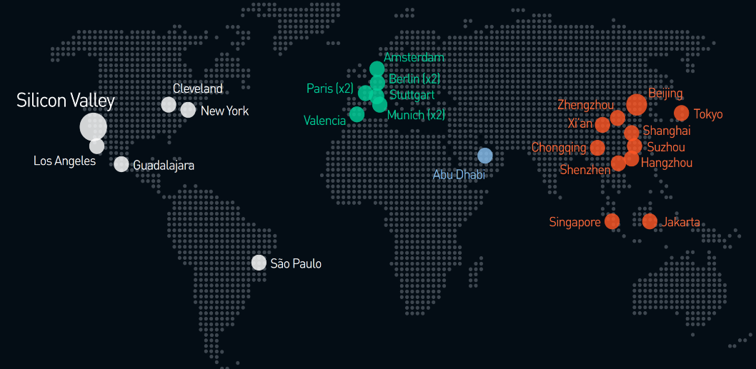
Plug and Play partnership
Plug and Play launch in ME - ADGM partnership
Largest corporate innovation platform
Goal: deliver a Fintech/Insurtech accelerator platform to connect leading financial institutions with startup solutions able to augment existing business and drive new revenues.
Steps of the program
Start up sourcing
Acceleration program /POC follow up
From POC to production
Pain points/ use cases
Worldwide network
Mature start ups
250+ large enterprises across 14 industries
Mentorship and exposure to entrepreneurial culture
Project management
POC
Collaborative review process / validate the learnings
Bridging the gap between POC and production

Slide 14
Digital health
mHealth

Slide 15
Digital health program
New possibilities through mHealth solutions will enhance our DMP participants’ member experience and help optimize operations
Education, coaching and target setting
Participant
Coventional delivery
Commitment to coaching plan
Commitment to treatment
Treatment
mHealth-based delivery
Chat
function
Telemetry
Data
Telemetry Data
[Future EHR]
Health Report
+ Enhanced data
Health Support Coach
Doctor
Clinical Data

Slide 16

One Drop
One Drop is a diabetes management platform that empowers people with diabetes to live healthier lives

Slide 17

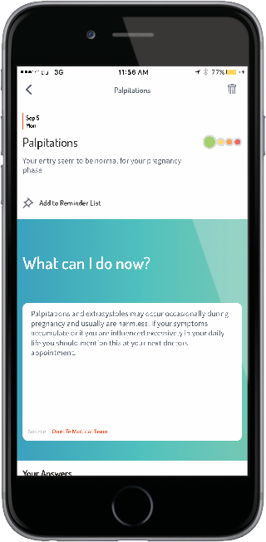
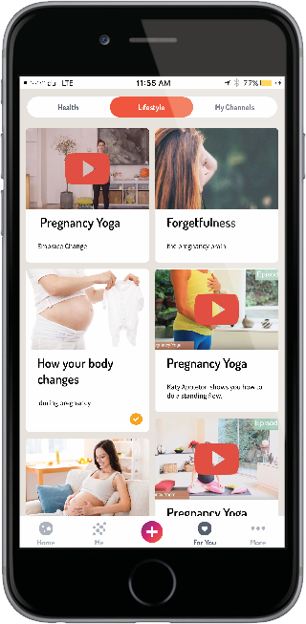
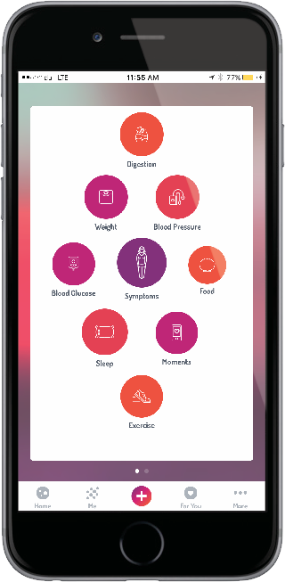
Femisphere
Femisphere tracks pregnancy related conditions and enables direct member chat communication with coaches to help make pregnancy a good experience
Track Medical
Symptoms
Track Mood
Emergency
Response Triggers
Track Meds
Engaging Content
Community
Activities

Slide 18

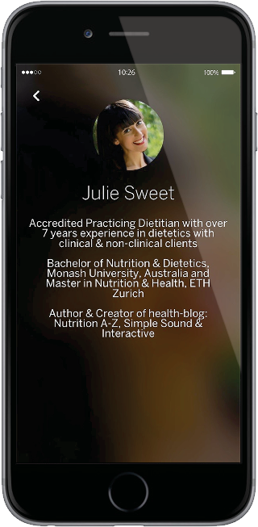
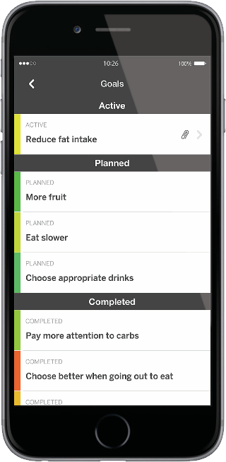
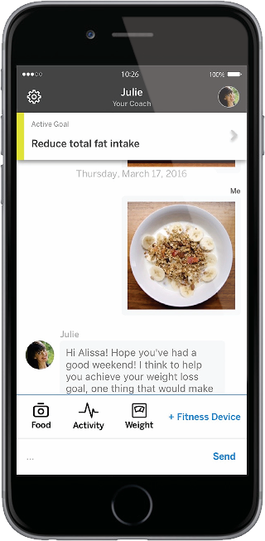
Oviva
Oviva delivers nutrition advice through one-to-one interaction between user and personal coach to help better manage food intake
Best in class
Nutrition Guides
Setting
Achievable Goals
Track Food / Upload Photo
Track Activity
Track Weight
Daily Coaching

Slide 19
Robotics process automation

Slide 20
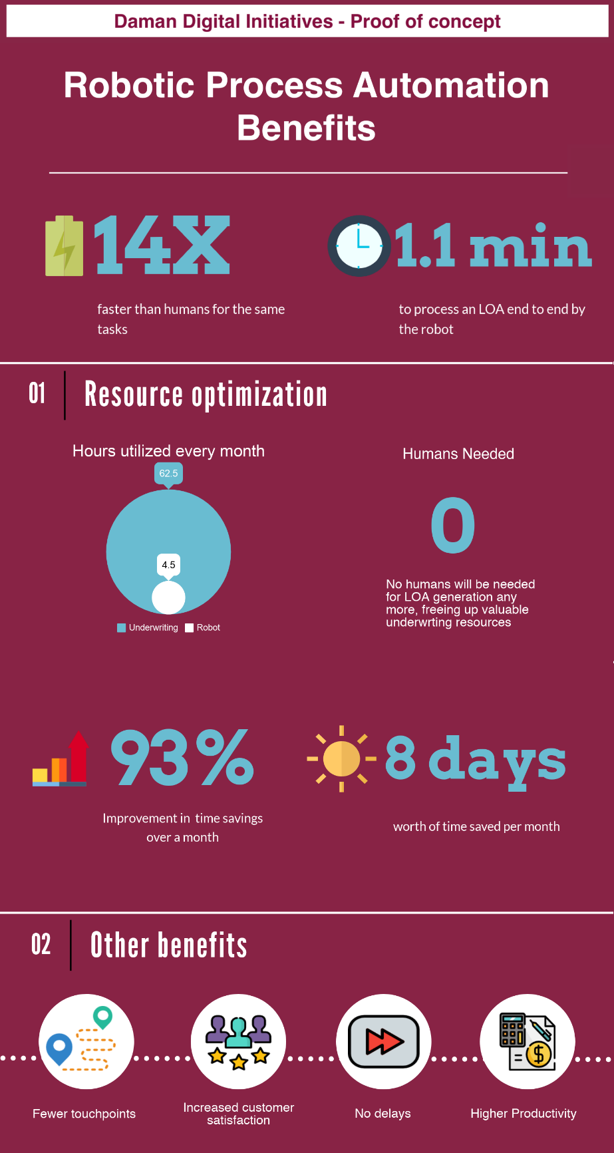
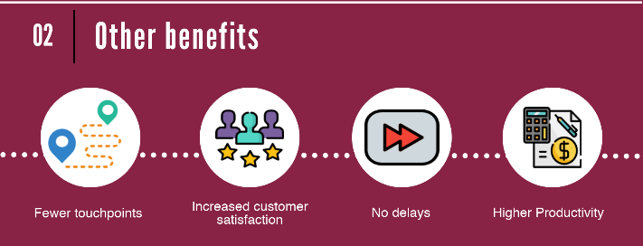
Robotic Process Automation

Slide 21
Predictive analysis in Healthcare

Slide 22
Predictive Analysis – What opportunities?
Predictive Analytics tries to better understand future events to improve bottom line and competitive advantage of a company
Application Areas [Examples]
Customer Management
Customer Segmentation Analytics
Customer Satisfaction Analytics
Cross-sell/Up-sell
Product Identification
Personalised treatments
Chat-bots
Customer Acquisition
Segmented Sales Approach
Campaign Management
Personalised Marketing
Productivity and Success Factors
Advanced Analytics and
Machine Learning opportunities in Health Insurance
Portfolio Risk Management
Selective Health Underwriting
Predictive Pricing
Premium Trend Analysis
Underwriting and Risk Management
Automated Claim Adjudication
Fraud/Abuse Identification
Opportunity Assessment
Policy Servicing and Claims Management

Slide 23
Predictive Analytics at Daman
Daman is using the power of advanced and predictive analytics in different areas to improve its competitive advantage
Risk Assessment/Underwriting
Anomaly Detection
1
2
Claims Management
Member Profiling
3
4
Notes:
“Use of statistical algorithms and machine learning techniques to identify the likelihood of future outcomes based on historical data […] to provide a best assessment of what will happen in the future”
SAS.com
Health Insurance companies move away from traditional retroactive analysis of historical data towards customized predictive analysis of behavior’s and trends
Understand member specific drivers within a larger population
Technology advances – volume – speed . Better computing power +
Growing volume of data, very often in electronic format
Faster and cheaper hardware, i.e. computer, memory
Better and cheaper software
Specialized companies offering services

Slide 24






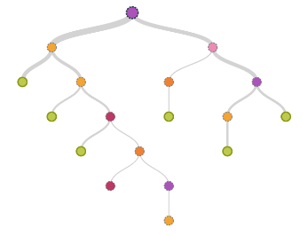
Pricing: Predicting future cost
To create a renewal pricing model that allows for a more informed approach in quoting renewal premiums.
Risk Assessment/Underwriting
1
Medical History
Demographic Data
PREDICT
Future Cost
Historical Cost
Coverage Information
ML

Slide 25
Anomaly detection: Profiling utilisation patterns
Advanced and predictive analytics are successfully used to detect and address anomalies in the in member behavior indicating fraud or abuse
Anomaly Detection
2
Health
Deteriorated
Chronic Patients
Sick
Suspicious
Odd
Healthy
Stable
Recovery
Healthy
Sick
Member View
Notes:
Machine learning algorisms help to better understand future cost of a health insurance scheme to better manage risks and medical cost
Optimize risk assessment and policy pricing with machine learning to complement “traditional” approaches
Enables (pro active) policy performance management for large policies with a clear value add to the client
Trend and cost scenarios for large populations
Support for policy and decision makers
Cooperation with Re-insurance partner
Detecting meaningful group combination in member behavior to identify anomalies and extreme spending patterns
Helps to identify signs of abuse or fraud
Methodology embedded as standard medical cost containment tool across our portfolios

Slide 26
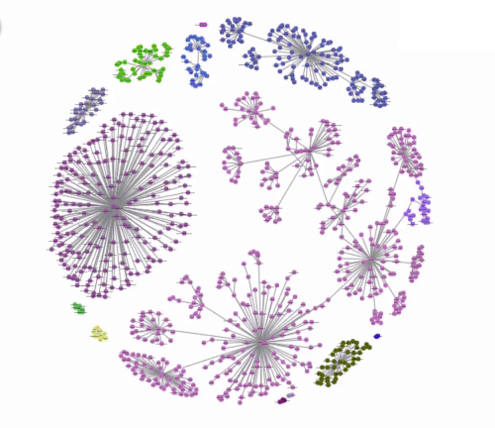
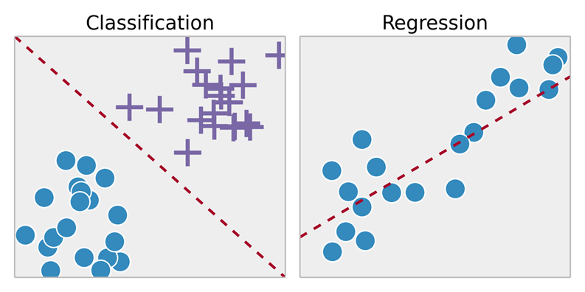
Machine learning based claims adjudication
We started a pilot to improve the automation rates in our claims management with the application of machine learning
Claims Management
3
Claims Similarity
Space
Predict Medical decision
Manual
Dynamic
Automation
Static
Automation
Accept
Reject
Machine Learning
Claims Volume
Notes:
Machine learning algorisms help to better understand future cost of a health insurance scheme to better manage risks and medical cost
Optimize risk assessment and policy pricing with machine learning to complement “traditional” approaches
Enables (pro active) policy performance management for large policies with a clear value add to the client
Trend and cost scenarios for large populations
Support for policy and decision makers
Cooperation with Re-insurance partner
Pilot started to develop a machine learning algorithm
Daman receives 37 million claims per year
Claims management was identified as major cost block with good potential to be further automated
Challenge to calibrate error margins against automation rates Arbitrage ! Automation rate versus error margins

Slide 27
Machine learning based claims adjudication
We started a pilot to improve the automation rates in our claims management with the application of machine learning
Claims Management
3
Claims Similarity
Space
Predict Medical decision
Manual
Dynamic
Automation
Static
Automation
Accept
Reject
Machine Learning
Claims Volume
Notes:
Pilot started to develop a machine learning algorithm
Daman receives 37 million claims per year
Claims management was identified as major cost block with good potential to be further automated
Challenge to calibrate error margins against automation rates Arbitrage ! Automation rate versus error margins

Slide 28
Predictive Analytics at Daman
The Machine Learning Algorithm took input from various parameters to calculate the Unified Risk Score
Member Profiling
4
Utilization Score
Demo-graphics
Health Status
Machine Learning
Unified Risk Score
Socio-economic Status
Cluster
Policy Details
Utilization Variables
Notes:
Machine learning algorisms help to better understand future cost of a health insurance scheme to better manage risks and medical cost
Optimize risk assessment and policy pricing with machine learning to complement “traditional” approaches
Enables (pro active) policy performance management for large policies with a clear value add to the client
Trend and cost scenarios for large populations
Support for policy and decision makers
Cooperation with Re-insurance partner

Slide 29
Predictive Analytics at Daman
The results of the member profiling allow us to optimize various elements along the value chain
Member Profiling
4
Medical Cost Contain-ment Initiatives
Concurrent use in Claims Processing
Custom Product Offerings
Provider Case Mix
Pre-emptive use in Author-isation
Prospective use for Recovery
Health Risk Score (HRS)
Unified Risk Score (URS)
Premium Setting
Risk Adjustment
Linking to High Utilizing Clinicians
Blocking Member Hoping
Notes:
The objective of the Member Profiling project was to derive a Member Specific Unified Risk Score
Knowing the health status of the member would be important for various other key initiatives
Data took into consideration 18 months of member data
Total time line for the project 2 months
Group members with similar clinical risk profiles and derive a Health Risk Score (HRS) = Health Status of the person from 0-9
Use machine learning model to cluster members based on utilization and derive a Unified Risk Score (URS) from 0 to 100 taking various parameter into consideration
Based on their scores, members can be categorized as High, Low and Medium Risk

Slide 30
THANK YOU !
Notes:
The different risk scores are used to optimize different elements of the value chain, i.e.
Underwriting for small and individual policies
Medical cost containment (i.e. anomaly detection)
Optimize cross- and up-selling of products and solutions
Member management
Optimize authorization processes
Etc.

